Slide 1
Introducing Sanskrit Wordnet
Prof. Malhar Kulkarni
Prof. Pushpak Bhattacharyya
&
Sanskrit Wordnet Team

Slide 2
Motivation
Sanskrit …
  as one of the oldest Indo-European language can provide basis for the linguistic analysis of modern Indo-European languages.
  as a heritage language needs to preserve the rich lexicon of this language.
  To preserve the traditional culture and knowledge translation of Sanskrit texts is needed
  Sanskrit wordnet can be a great help in developing Machine aided translation (MAT) system for Sanksrit.
  Text Search facility can be developed using the wordlist of Sanskrit wordnet.
  Sanskrit has a rich lexical tradition but there is no single reference containing all the these lexicas.

Slide 3
Sanskrit language and its relation with modern Indo-Aryan languages
Sanskrit is the oldest member of the Indo-Aryan language family, a sub branch of Indo-Iranian, which in turn is a branch of Indo European language family.
Traditional four-fold division of the lexical units of Indian languages –
  तत्सम tatsama - words having their origin in Sanskrit and accepted in the modern Indo-Aryan languages without any change in their phonology.
  तद्भव tadbhava- words which have their origin in Sanskrit but their phonological forms are changed as per the rules of the modern Indo-Aryan languages.
  देशी deshī- words which are the native words of the particular language and
  विदेशी videshī - words borrowed from foreign languages.

Slide 4
The links to तत्सम tatsama and तद्भव tadbhava words, in particular, will be a great pan-Indian linguistic resource for computational purposes.
HWN Synset | Tatsam word | HWN synset | English meaning
{तुलसी, पावनी, बहुमंजरी, वृंदा, वृन्दा, वैष्णवी, भारवी, मंजरीक, विश्वपावन, विश्व-पूजिता, पुष्पसारा, त्रिदशमंजरी, त्रिदशमञ्जरी, तीव्रा, पत्रपुष्पा, श्रीमंजरी,श्रीमञ्जरी, अमृता} | तुलसी | तुलसी | basil
 | वृन्दा | तुलसी
 | वैष्णवी | तुलसी
 | पावनी | तुलसी
 | पत्रपुष्पा | तुलसी
{भौंह,भौं,भ्रू,भृकुटी, तेवर,कोदंड,कोडंड,अबरू} | भ्रू | भौंह | eyebrow, brow, supercilium
 | भृकुटी | भौंह
{पेशी, माँस-पेशी, मांस-पेशी, माँसपेशी, मांसपेशी, माँस पेशी, मांस पेशी, नस} | पेशी | पेशी | muscle, musculus
 | मांसपेशी | पेशी
{बैंगन,बैगन,भंटा,भाँटा, शाकबिल्व,शाकबिल्वक, वृंताक,वृन्ताक,नीलवृषा, शाकश्रेष्ठा,वृंताकी, वागुण,वरा, चित्रफला,रक्तकंठ, रक्तकण्ठ,निद्रालु, नीलफला,नटपत्रिका} | शाकबिल्व | बैंगन | eggplant,aubergine, mad_apple
 | शाकश्रेष्ठा | बैंगन
 | चित्रफला | बैंगन
 | वृन्ताक | बैंगन
 | निद्रालु | बैंगन
 | नीलफल | बैंगन

Slide 5
Rich lexical tradition of Sanskrit
Mono-lingual Sanskrit-Sanskrit traditional lexicas that arranged lexical material from the point of view of synonymy as well as homonymy, –
  1.Naamamaalikaa of Bhoja (11 C)
  2.SiddhashabdaarNava of Sahajakirti- (17th C)
  3.Shaaradiiyaakhyaanaamamaalaa of Harsakirti- (17th C)
  4.Paryaayashabdaratna of Dhananjaya-Bhatta.
  5.Koshakalpataru
  6.Naanaartharatnamaalaa of Irugapa Dandadhinatha (14th C)
  7.Naanaarthamañjarii of Raghava
  8.DharaNiikosha of Dharanidas a (12th C)
  9.Shivakosa of Sivadatta-Misra
  10.Ekaarthanaamamaalaa-vyaksharanamamaalaa of Saubhari
  11.Paramaanandiiyanaamamaalaa of Makrandadasa
Modern monolingual and bilingual dictionaries-
  The first modern-day dictionary of Sanskrit was the Sanskrit-English Dictionary compiled by Professor H.H. Wilson and published in 1819 (Wilson, 1819).
  Monier Williams Sanskrit-English Dictionary (Available online)
  Two Indian mono-lingual (Sanskrit to Sanskrit) dictionaries-
    Shabdakalpadruma (Deb, 1988) of Pt. Sir Raja Radhakanta Dev and
    Vacasptyam (Bhattacharya, 2003) compiled by Pt Taranatha Tarkavacaspati.
Sanskrit wordnet mainly relies on –
  Monier Williams Dictionary
  Shabdakalpadruma
  Vacasptyam
  Apte’s Sanskrit Dictionary

Slide 6
Building Sanskrit Wordnet- Expansion approach
There are two methods to develop a Wordnet:
  (1) Expand method- a wordnet is constructed based on an existing wordnet.
  (2) Merge method- sub-Wordnets for specific domains are built and later merged.
For Sanskrit Wordnet, the Hindi wordnet is considered as the source resource.
Though expanded from Hindi wordnet, care was taken to ensure that Sanskrit wordnet captures the real lexical structure of Sanskrit language.
Sanskrit wordnet follows the hierarchy preservation principle (HPP) (Tufis et al., 2008).
  In the hierarchy of the Hindi wordnet, if synset H2 is a hyponym of synset H1, and the translation equivalents in the Sanskrit wordnet for H1 and H2 are S1 and S2 respectively, then in the hierarchy of Sanskrit wordnet S2 should be a hyponym of synset S1.
Notes:
Thus, in the expansion approach lexicographers are spared the task of establishing afresh semantic relations for the synsets of Sanskrit wordnet.

Slide 7
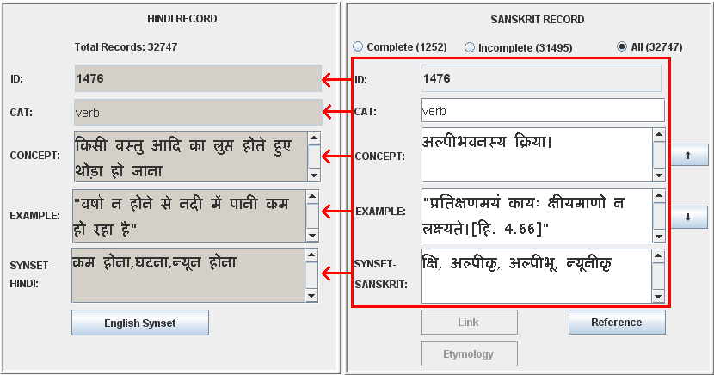
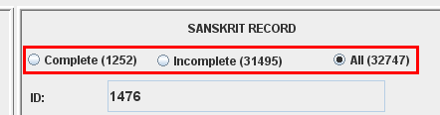
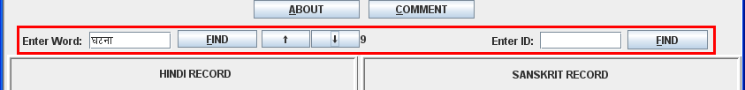
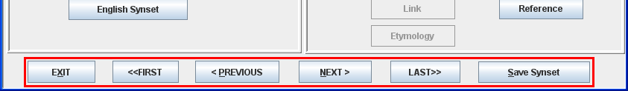
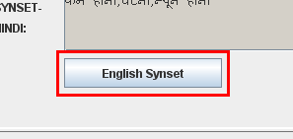
Lexicographers interface
Synset creation in expansion approach
Records of source and target synsets
ID search and word search
Browsing synsets
View English synset in a pop-up window

Slide 8
Synset creation in the first phase
Initial word list based approach-
Problems faced:
List of total words in the Hindi wordnet
105157
List 1-|Most frequent words of Sanskrit| 8338
List 2-| Unique words of the Sanskrit epics| 127796
Domain based approach (which later extended to all Indian language wordnets): Based on Naravane’s भारतीय व्यवहार कोश most common words of Indian languages from following domains are selected.
Part of Speech distribution: 1512 Nouns, 225 Verbs, 180 Adjectives and 52 adverbs
1) Grains and Cereals | 2) Limbs of Humans | 3) Medical treatment | 4) Tools & implements | 5) Worms & Insects
6) Minerals | 7) Food and Drinks | 8)Games & sports | 9) Ornaments & Trinkets | 10) Household articles
11) Limbs of animals | 12) Post office | 13) Vegetables | 14) Directions | 15) Country
16) Religion | 17) Court | 18) Birds | 19) Trees & plants | 20) Dress
21) Nature | 22) Animals | 23) Fruits | 24) Flowers | 25) Young-ones of animals
26) Amusement | 27) Spices | 28) Weights & measures | 29) Colours | 30) Relatives
31) Diseases | 32) Reptiles | 33) Conveyances | 34) Occupations | 35) Education
36) Time | 37) Government | 38) Verbs | 39) Adverbs | 40) Abstract nouns
41) Adjectives | 42) Prepositions | 43) Numerals | 44) Conjunctions | 45) Collective words
46) Pronouns | 47) Ordinals | 48) Feminines | 49) Interjections | 50) War
51) House | 52) Miscellaneous

Slide 9
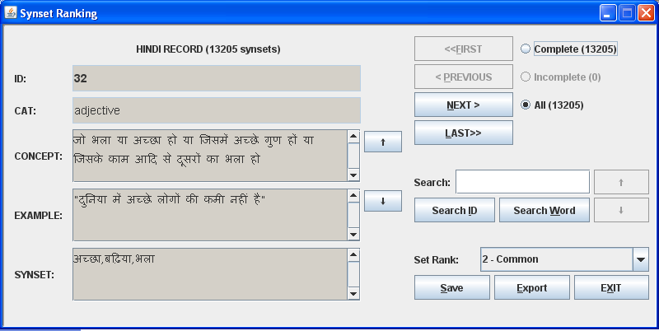
Synset creation in the second phase
Common concepts used in Indian languages are selected from the total Hindi wordnet synsets.
  Selection procedure-
    Stage I- All Hindi wordnet synsets were ranked by 6 language resource persons of Hindi, Marathi, Sanskrit and Kannada.
      >>> 13205 concepts are selected.
    Stage 2
      Group voting
      Online voting
        >>> 10312 concepts are selected.
Synset Ranking tool

Slide 10
Synset creation in Expansion approach
Creating synonymous sets –
Understanding Hindi wordnet synset.
Looking for the most common word for the concept expressed by Hindi wordnet synset
  Collecting synonymous words from traditional lexical resources, modern monolingual (शब्दकल्पद्रुम & वाचस्पत्यम्)and bilingual dictionaries (Monier Williams’ Dictionary, Apte’s Dictionar and online spoken Sanskrit Dictionary).
  Arranging words according to the frequency-
    From most common modern or classical word to the least used Vedic word.

Slide 11
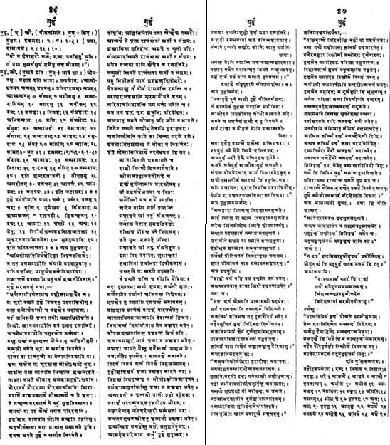
Page 1
Page 2
Head word युद्ध
Gloss
Gloss or etymology?
Set of synonymous words in classical Sanskrit
Problems faced by lexicographers:
Large number of synonymous words.
Different words used in different periods.
Glosses are etymological and sometimes do help in wordnet creation.
Examples are either too lengthy (10-15 lines) or too small (not even a complete sentence.)
Objects related to or used in युद्ध
Set of synonymous words in Vedic Sanskrit

Slide 12
Sanskrit Wordnet as a one single reference for researchers and translators.
युद्ध yuddha war
Monier Williams Dictionary:
अनीक, अभ्यामर्द, अम्बरीष, अरर, आजि, आनर्त, आयोधन, आहव, आहाव, कण्ठाल, कन्दल, खज, न, नदनु, निग्रहण, पुष्कर, प्रविदारण, प्रसर, बलज, भण्डन, भर, भीमर, युत्कार, युद्ध, योध, योधन, रण्य, राटि, रु, वराक, विदथ, विदार, विदारण, विमर्द, विमर्दन, शम्बर, शिलीमुख, संयत्, संयुग, संस्फोट, संस्फेट, संक्रन्द, संक्रन्दन, संख्य, संगथ, समनीक, समाघात, समुदय, समुदाय, समुद्धर्ष, समोह, समर, समृति, सम्पराय, हान्त्र, हार
Spoken Sanskrit Dictionary:
युद्ध, युध्, संग्राम, समर, आयोधन, आहव , रण्य
7 words
56 words
7 words
Apate’s Sanskrit-English Dictionary:
विग्रहः, संग्रहारः, वैरारंभः, वैरं, संग्रामः, युद्धं, रणं
Shabdakalpadruma - युद्धम्, आयोधनम्, जम्यम्, प्रधनम्, प्रविदारणम्, मृधम्, आस्कन्दनम्, संङ्ख्यम्, समीकम्, साम्परायिकम्, समरम्, अनीकम्, रणः, कलहः, विग्रहः, संप्रहारः, अभिसम्पातः, कलिः, संस्फोटः, संयुगः, अभ्यामर्दः, समाघातः, संग्रामः, अभ्यागमः, आहवः, समुदायः, संयत्, समितिः, आजिः, समित्, युत्, संरावः, आनाहः, सम्परायकः, विदारः, दारणम्, संवित्, सम्परायः, अम्बरीषम्, बलजम्, आनर्तः, अभिमरः, समुदयः
--------------------------------------------------------------------------------------------------------------------------------------------
रणः, विवाक्, विखादः, नदनुः, भरे, आक्रन्दे, आहवे, आजौ, पृतनाज्यम्, अभीके, समीके, ममसत्यम्, नेमधिता, सङ्काः, समितिः, समनम्, मीळ् हे, पृतनाः, स्पृधः, मृधः, पृत्सु, समत्सु, समर्ये, समरणे, समोहे, समिथे, सङ्खे, सङ्गे, संयुगे, सङ्गथे, सङ्गमे, वृत्रतूर्ये, पृक्षे, आणौ, शूरसातौ, वाजसातौ, समनीके, खले, खजे, पौंस्ये, महाधने, वाजे, अजम्, सद्म, संयत्, संवतः
38 words- Classical Sanskrit
46 words- Vedic Sanskrit
Lexicographer’s task
Collecting words→ Eliminating duplicate entries → Arranging them in order
Sanskrit wordnet – 97 words

Slide 13
Inserting Concepts or glosses in the Sanskrit Wordnet
A combination of the glosses given in dictionaries like Shabdakalpadruma and the translation of the gloss of the Hindi wordnet synset is used to create the Sanskrit synset glosses.
While writing the gloss, complicated सन्धिs sandhis^{[1]} and समासs samAsas (compounds) are avoided.
Whenever lengthy compounds (having 5-6 members) became necessary, the members of the compounds were invariably joined with the hyphen symbol (-) as in: “अन्य-स्थान-संयोगानुकूल-व्यापार meaning the activity that is helpful in reaching a place”
the gloss of a verb in Sanskrit is generally created using technical terms like व्यापार vyApAra ‘action’, जन्य janya ‘produced,’ अनुकूल anukUla ‘helpful,’ etc
[1] Phonological conjoining

Slide 14
Problems faced in Expansion approach
Difficulty of finding equivalent words:
चाय
(Tea)
  चाय के पौधे की पत्तियों को पानी में डालकर चीनी, दूध आदि मिलाकर बनाया हुआ पेय पदार्थ
    cAya ke paudhe kI pattiyon ko pAnI mein DAlkar cinI dUdha Adi milAkar banAyA huA peya
    padArtha
    (A drink prepared by mixing the leaves of the Tea-plant with sugar, milk and water)
But Sanskrit does not have a word of its own for this concept.
Monier Williams in his Sanskrit-English dictionary (MW hereafter) suggests that “चहा” cahA (which is actually a Marathi word) should be used as a borrowed word.
In the dictionary of spoken Sanskrit we find two different regional words “चाय” cAya and “चाया” cAyA belonging to the North and South regions of India.
चायः
(Tea)
चायः चहा एवंविधैः शब्दैः भारतीय-भाषासु प्रसिद्धस्य क्षुपस्य शुष्कपर्णानां चूर्णम् उष्णजले अभिपच्य तस्मिन् द्रवे
शर्करादुग्धादीन् संमिश्र्य निर्मितम् उष्णपेयम्।
cAyaH cahA evaMvidhaiH shabdaiH bhAratIya-bhASAsu prasiddhasya kSupasya shuSka-parNAnAM
cUrNam uSNajale abhipacya tasmin drave sharkarA-dugdhAdIn saMmishrya nirmitam uSNapeyam
(A hot drink which is prepared by first mixing the leaves of the a plant, which is famous by the names
like चहा cahA, चाय cAya, etc. in the Indian languages, into hot water and then mixing it with sugar and milk)

Slide 15
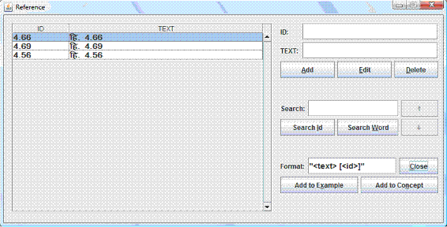
Use of quotations example field:
Generally, examples associated with Hindi synsets are translated only if they read sensible when translated into Sanskrit.
In some cases, quotations from the Sanskrit texts are included in the example field.
A special field has been created to record the source of the quotations. This citation field is incorporated in the lexicographer's interface:
The example with the citation is inserted in this format:
(5) "शशि-दिवाकरयोर्ग्रहपीडनम्।" [भर्तृ.2.91]
shashi-divAkarayor grahapIDanaM [bhartR 2.91]
(the eclipse of Sun and Moon).
Here, [भर्तृ.2.91] indicates the place of the quotation in the original Sanskrit text authored by Bhartrhari.
2.91
भर्तृ.2.91
2.91
भर्तृ.2.91

Slide 16
Coverage of words in Sanskrit wordnet:
Taking into consideration the linguistic change and time, it is possible to classify Sanskrit language into three periods-
  (1) Vedic period-beginning of Vedic Sanskrit can be traced as early as around 1500 BCE and Vedas are written using literals of that time,
  (2) Classical Sanskrit- A significant form of post-Vedic Sanskrit is found in the Sanskrit beginning with the Hindu Epics—the Ramayana and the Mahabharata.
  (3) Modern Sanskrit.
Synset creation
  collecting words of all the period
    arrange words as per the frequency
[The general policy adopted for synset making is to start with the most frequent
words of modern Sanskrit and to close the synset with the least frequent word of
Vedic Sanskrit. ]

Slide 17
Special features of Sanskrit wordnet
Verbal concepts:
  In Hindi wordnet, verbs are not inserted in their root forms.
  Instead, their dictionary forms are included in the synset. For example-
    होना honA (to be),
    करना karanA (to do),
    खाना khAnA (to eat),
    पीना pInA (to drink) etc.
  The last ना nA is dropped through suffix stripping in verb morphology and the verb forms are generated using only the initial parts like हो ho, कर kara, खा khA, पी pI.
  Sanskrit lexicographers have not conformed to this practice and have inserted the root forms of verbs like भू bhU (to be), कृ kR (to do), खाद् khAd (to eat), पा pA (to drink), in verbal synsets.

Slide 18
Gender
Sanskrit has grammatical gender. The following practice is followed for tackling the issue of gender in Sanskrit wordnet:
  (1) In case of nouns all gender variations are included in the synset.
  (2) Adjectives in Sanskrit have no gender of their own. They take the gender of the nouns which they qualify.
    Hence in the synset of adjectives only root forms are included.
  (3) Adverbs- Technically adverbs in Sanskrit do not get conjugated as nouns and adjectives. But, we find that some adverbs have विभक्ति (case ending) suffixes attached to them indicating the closed form of the word in that particular विभक्ति (case ending).
    In such cases, they are included as they are, i.e., in the closed विभक्ति form

Slide 19
Challenges
One of main challenges in creating the Sanskrit wordnet is dealing with the sheer volume of lexical knowledge accumulated over at least 2000 years.
  The synsets tend to become long to accommodate coverage of words for a concept.
Extremely rich morphology of Sanskrit- which produces new words from simple elements.
The question of trade-off between a complex morphological interface to the lexical data and the amount of lexicalization needs to be investigated

Slide 20
Future work
Use of ontology of नव्य-न्याय (Navya-NyAya)
  The traditional Sanskrit Texts on Philosophy as well as Medicine contain various discussions on ontological categories and hierarchies.
  These texts are closely related to the grammar of the Sanskrit Language.
  The comparison of these ontological structures and hierarchies to the existing one coming from the Hindi wordnet may shed light on new Indowordnet specific issues.
धातु (dhAtu) based WN
  There are theories in Sanksrit texts which adhere to the view that all nouns are derived from verbal roots.
  There is a need to test this theory and build a lexical structure where all the verbal roots will be at the nodal level with connected nouns at the leaf level.
    [A brief introduction of this is available in (Kulkarni and Bhattacharyya, 2009). ]

Slide 21
References
Taranatha Tarkavacaspati Bhattacharya, editor. 2003. Vacaspatyam, volume 1-6 of Chaukhamba Sanskrit Book Series. Chaukhamba, Banares.
Raja Radhakanta Deb, editor. 1988. Shabdakalpadruma, volume 1-5. Nag Publishers, 2003 edition. Delhi.
Malhar Kulkarni and Pushpak Bhattacharyya. 2009. Verbal roots in the Sanskrit wordnet. In G. Huet, Amba Kulkarni, and Peter Scharf, editors, Sanskrit Computational Linguistics, Lecture Notes in Computer Science:328–338, Berlin/Heidelberg. Springer-Verlag.
Malhar Kulkarni. 2008. Lexicographic traditions in India and Sanskrit. Journal of Language Technology, (1):160–165.
Abhishek G. Nanda. 2009. Tools and interfaces for wordnet construction, linking and maintenance. B. tech project report, Indian Institute of Technology Bombay, Mumbai.
Vishwanath Dinkar Naravane. 1961. Bharatiya Vyavahara Kosha: Solah Bhasao ka kosha. Triveni Samgama. [In HIndi.].

